Slide 1


Docker Basics By Sanjay Sharma, Vinsten Leon Dsouza, Riya Yadav,
Soumyajyoti Mahalanobish, Karan Tyagi
SDET 1.0
Batch 150+ Engineering Graduates
Copyright © HashedIn Inc. All rights reserved

Slide 2

Agenda
Familiarize with docker and containers
Understand basic docker concepts
Understand minimal commands to work with dockers
Learn enough to use throughout the HU

Slide 3
Desktops
Physical Server
Application
Application
Application
OS

Slide 4
Virtual Machines, or VMs
Strong Isolation &
Security
Physical Server
Application
Application
Application
VM
Guest OS
Guest OS
Guest OS
Wastage, Redundant OS
HyperVisor
Host OS

Slide 5
Containers
Weaker Isolation & Security
Physical Server
Application
Application
Application
Container
Common Libraries
Common Libraries
Common Libraries
No Guest OS => Cannot run different OS
Docker
Host OS provides namespaces & cgroups for isolation
Host OS

Slide 6
Comparison
 | Dockers | VMs
Host OS | HostOS required | Type 1 do not require HostOS
Guest OS | Guest OS not installed; lightweight | Guest OS is installed
Resources | Better in resource management | Poorly allocated and managed resources; more wastage
Boot Time | Within seconds | Few minutes
Support | Pre-built images are available | Start from scratch every time
Security | Less secure unless configured | More secure due to isolated kernel

Slide 7

VMs are still in demand
EC2 instance is a VM
And they are not going away, even with Docker!
Docker is usually run within a VM.

Slide 8
Need of Dockers
Microservices - Need a way to run many services locally
Multiple programming languages - Want a consistent way to deploy
Azure / GCP / DO growing - Customers don’t want lockin to a cloud provider
Industry shift towards containers - All clouds support docker, customers want docker and new hashers know docker
Better with CI / CD - More control of dev team, via code
Encourage Experimentation - Anyone should be able to deploy PoCs
DevOps - Devs need to acquire an operations mindset
Consistency - Runs same everywhere. “It runs on my machine” problem solved

Slide 9
Process Workflow
docker push
acme:v1.2
acme:v1.3
example:v2
Repository
Source Code
Images have tags, similar to versions of software
build
run
Image
Container
Like an executable binary
Like a
process
Dockerfile
Dev Computer
or CI Server
Connects to Dockerhub

Slide 10
Commands Workflow
1. | Create Image | Write a Dockerfile and use docker build to create an image on local machine or build machine docker build -t myfirstimage .
2. | Run & Test on Local | Application URL on local browser docker run -p 4000:80 myfirstimage
3 | Push Image | Push your image on portus.hashedin.com docker login portus.hashedin.com docker tag <imageid> portus.hashedin.com/<portususername>/myfirstimage:v1 docker push portus.hashedin.com/<portususername>/myfirstimage:v1
4 | Pull Image | Pull required image from portus.hashedin.com docker pull portus.hashedin.com/<portususername>/myfirstimage:v1

Slide 11
Create an Image
Host OS
Context Dir (source code + Dockerfile + .dockerignore)
docker build <context-dir>
FROM python:3.7-alpine
Docker Engine
RUN mkdir /code
WORKDIR /code
Base Layer
Image
COPY requirements.txt /code/
Layer 1
RUN pip install -r requirements.txt COPY . /code/ CMD gunicorn todoapp.wsgi
Layer 2
Layer 3
...
* This is NOT PRODUCTION READY as it violates several Dockerfile best practices

Slide 12
Hands-on - Create your first image
Refer - https://docs.docker.com/v17.09/get-started/part2/#define-a-container-with-dockerfile verify with ‘docker images’ command
20 mins
’

Slide 13
Containers
Host OS
Containers cannot access files, network, processes etc. from the host machine.
Running ps -ef inside the container will only list 1 process
Container #1
Container #2
Container #3
Docker Engine

Slide 14
How does it work?
Host OS
/data inside the container maps to /user/mysql/data on the host machine
Inside the container, our app.py runs on port 80.
But outside, the port is exposed as 4000.
app.py
4000
80
/data
/user/mysql/data
Docker Engine
A container have all the required resources attached to it or has a way to to do it - Storage, RAM, Processing, Cache, Ports, health check, etc.

Slide 15
Run, Entrypoint and CMD
RUN lets you execute commands inside of your Docker image. These commands get executed once at build time and get written into your Docker image as a new layer.
ENTRYPOINT is the executable used to start the container
CMD is the default arguments provided to the ENTRYPOINT
Both Entrypoint and CMD can be set in the Dockerfile (hence Image). Both can be overridden by the operator.
For mysql, ENTRYPOINT = docker-entrypoint.sh

Slide 16
Docker Best Practices
Make sure that you’re pushing the image to private Dockerhub repository.
Do not Store Sensitive Data inside a Container Image
- The tokens and keys must be kept outside of the Dockerfile
Scan docker image for known vulnerabilities
one way of protecting against vulnerabilities in open source security software is to use tools such as Snyk
Use multi-stage build for small and secure images
For smaller base images, use alpine and slim
Use LABEL to Catalog your Images
Ex: LABEL maintainer="ab@abcd.com"
Use a Non-Root Container
By default, Docker containers run as root. This is not desirable due to security concerns.
Do not Store Data or Logs Inside Containers
Containers are ideal for stateless applications that are transient in nature and are meant to be ephemeral aka (short-lived).
Use only trusted base images when building your containers.
Always use the most up to date version of Docker.
Use minimal base images that don’t include unnecessary software packages that could lead to a larger attack surface.

Slide 17
Hands-on - Run your first Container
Refer - https://docs.docker.com/v17.09/get-started/part2/#the-app-itself verify with ‘docker containers list’ command
20 mins
’

Slide 18
Overview
Image
Environment Variables
Starts from an image
Configured using env
Entrypoint & CMD
Container
is just a
Container
has a
Container
Process
Commands
docker run <image> - start a container
docker ps - list containers
docker kill <id> - kill a container
docker container prune - remove stopped containers
can have
Volume
CPU
Memory
Volume
can expose
Volume
Can have CPU / Memory constraints
Port
Port
Port
-v /outside:/inside
-p 80:8080

Slide 19
Push an image
Just like any code, docker engine allows us to push, save and share our images.
Dockehub.com is just like github.com; common base images available, you can collaborate, may have private registry
Lately it is called Docker Distribution rather than Docker Registry
The core of Docker registry remains same but there are many tools on top of it to manage repositories
Few alternatives to the Dockerhub are Portus, Nexus etc.
Dockerhub.com is default, if registries URLs are not explicitly mentioned.

Slide 20
Docker Hub
Docker Hub is a cloud-based repository in which Docker users and partners create, test, store and distribute container images. Through Docker Hub, a user can access public, open-source image repositories, as well as use a space to create their own private repositories.
How Docker Hub repositories work
Docker Hub where in users upload and store container images. Public repositories enable users to share and collaborate on container images. Private repositories protect any sensitive or proprietary data from unauthorized persons.
To push an image to Docker Hub, a user must do the following:
Log into Docker Cloud with the docker login command.
Tag the specified image using docker tag.
Push the image to Docker Hub with docker push.
Check Docker Cloud to ensure the image appears in her repository.
A user pulls an image from Docker Hub with the docker pull command.

Slide 21
Hands-on - Push image to DockerHub

Slide 22
Docker Networks
One of the reasons Docker containers and services are so powerful is that you can connect them together, or connect them to non-Docker workloads.
Network drivers:-
Bridge :- Bridge networks are usually used when your applications run in standalone containers that need to communicate.
Host:- For standalone containers, remove network isolation between the container and the Docker host, and use the host’s networking directly
Overlay:- Overlay networks connect multiple Docker daemons together and enable swarm services to communicate with each other.
Macvlan:-Macvlan networks allow you to assign a MAC address to a container, making it appear as a physical device on your network.
None:- For this container, disable all networking. Usually used in conjunction with a custom network driver. none is not available for swarm services.

Slide 23
Docker Logging
Docker has logging mechanisms in place which can be used to debug issues as and when they occur. There is logging at
the daemon level and at the container level.
Daemon Level Logging:
At the daemon logging level, there are four levels of logging available −
Debug − It details all the possible information handled by the daemon process.
Info − It details all the errors + Information handled by the daemon process.
Errors − It details all the errors handled by the daemon process.
Fatal − It only details all the fatal errors handled by the daemon process.
Stop the docker daemon process, if it is already running. sudo service docker stop
Start the docker daemon process by specifying logging option
sudo dockerd –l debug &
dockerd is the executable for the docker daemon process, -l for logging option & to come back to the command prompt
Container Level Logging: docker logs containerid containerID − This is the ID of the container for which you need to see the logs.

Slide 24
Docker Volumes
Volumes are the preferred mechanism for persisting data generated by and used by Docker containers
Volumes are saved in the host filesystem (/var/lib/docker/volumes/) which is owned and maintained by docker. Any other non-docker process can’t access it
// create a volume
docker volume create new_vol
// list volumes
docker volume ls
// inspect volumes
docker volume inspect new_vol
// removing volumes
docker volume rm new_vol
// Start a Container with volume
docker run -d --name devtest --mount source=myvol2,target=/app nginx:latest

Slide 25
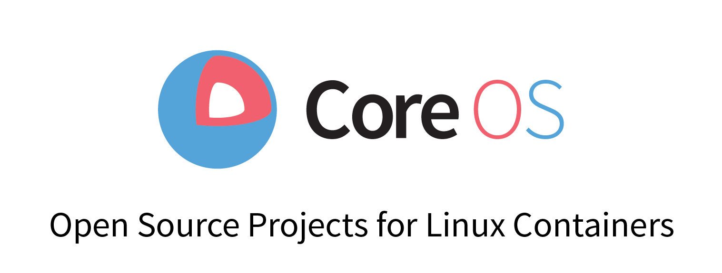

Containerising Tools other than Docker
CoreOs rkt:
Rkt supports two types of images: Docker and appc. It supports features like its pod-based process that works out of the box with Kubernetes, also support for Trusted Platform Modules (TPM).
Some potential drawbacks include a lack of OCI compliance. Rkt is no longer developing appc. Also, Rklet (CRI) is still under development. Red Hat recently acquired CoreOS, the company behind rkt.
Mesos Containerizer:
Developed by Apache, Mesos offers quality performance, supporting both Docker and appc image types. OCI support is likely coming, with indications they will follow Docker’s adoption trajectory.
It can be integrated well with Spark and Flink.
A potential downside is that you can’t run these containers standalone i.e it required complete Mesos Framework

Slide 26

Containerd:
containerd is described as “an industry-standard container runtime with an emphasis on simplicity, robustness and portability.”
An incubating project of the Cloud Native Computing Foundation, containerd is available as a daemon for Linux or Windows.
Containerd supports OCI images, is designed to work in concert with gRPC and comes with many container lifecycle management features. View the docs here for more information.

Slide 27
Docker Installation
Installation on linux:
Reference :- get.docker.com
curl -fsSL https://get.docker.com -o get-docker.sh
sh get-docker.sh
Installation on windows:
Open - https://docs.docker.com/docker-for-windows/install/
Navigate to Download from Docker Hub and Get Docker
To execute the docker commands open powershell and run the docker commands
Note: Docker can be installed only on windows 10 from 64-bit version or windows 2016 server edition and once docker is installed on windows it activates an application called Hyper-v this will not allow any other virtualization to run on our machine

Slide 28
Installation on Mac:
Open - https://docs.docker.com/docker-for-mac/install/
Navigate to Download from Docker Hub and Get Docker
Note:
Mac hardware must be a 2010 or a newer model with an Intel processor, with Intel’s hardware support for memory management unit (MMU) virtualization, including Extended Page Tables (EPT) and Unrestricted Mode. You can check to see if your machine has this support by running the following command in a terminal: sysctl kern.hv_support If your Mac supports the Hypervisor framework, the command prints kern.hv_support: 1.
macOS must be version 10.14 or newer. That is, Mojave, Catalina, or Big Sur. We recommend upgrading to the latest version of macOS. If you experience any issues after upgrading your macOS to version 10.15, you must install the latest version of Docker Desktop to be compatible with this version of macOS.
At least 4 GB of RAM.
VirtualBox prior to version 4.3.30 must not be installed as it is not compatible with Docker Desktop.

Slide 29
Can Docker replace VM’s?
Docker containers are generally faster and less resource-intensive than virtual machines, but full VMware virtualization still has its unique core benefits—namely, security and isolation. So for application/software portability, Docker is your safest bet. For machine portability and greater isolation, go with VM’s.

Slide 30
Docker Use cases
i. Simplifying Configuration:
Simplifying configuration is the primary use case of Docker. As VMs offers the ability to run any platform with its own config on top of our infrastructure, Docker also offers this same capability even without the overhead of a virtual machine.
ii. Code Pipeline Management
Docker eases the code development and deployment pipeline and offers a consistent environment for the application from dev through production.
iii. Multi-tenancy
Basically, it was easy and inexpensive to create isolated environments using Docker especially for running multiple instances of app tiers for each tenant.
iv. Developer Productivity
Basically, we need to achieve two major goals, in the development environment. First, we need the development environment to be as close as possible to produce. And, secondly, we need the development environment to be as fast as possible for the interactive purpose.

Slide 31
In order to attain the first goal, it is must that every service runs on its own VM to reflect how the production application runs. The low overhead of Docker easily permits a few dozen services to run inside different containers on the development environment that generally has a low memory capacity.
Further, to attain the next goal, we make use of docker’s shared volumes to make the application code available to the container from the host OS. As a result, the developer is allowed to edit the source code from his platform & editor of choice and also is able to see the changes right away as the applications run with the help of same source code by running environment set inside the Docker container
v. Rapid Deployment
It is possible to create Docker containers in milliseconds. This is not achieved by booting up an OS but by creating containers and just running the application process. And, since Docker images are immutable in nature they ensure us the peace of mind that things will work exactly the way they have been working or exactly they are supposed to work.

Slide 32
Not to use Docker?
i. Complicated app and no sysadmin
Basically, using a pre-made Dockerfile or pulling an existing image will not be sufficient for large or complicated applications. Because, editing, Building, and managing communication between multiple containers on multiple servers is quite a time-consuming task.
ii. Performance is critical to your application
When it comes to performance, Docker shines compared to virtual machines due to the reason that containers share the host kernel and do not emulate a full operating system. Although, it does impose performance costs. Processes running on the native OS will run more quiet and fast in comparison to the process within a container. We may want to avoid Docker if we need to get the best possible performance out of your server.
iii. You don’t want upgrade hassles
As it is a new technology so some work is still under development. Hence, we might have to update versions frequently, to get new features.

Slide 33
iv. Security is critical to your application
Especially for more complicated applications, Docker’s containerization approach raises its own security challenges. So, it requires attention from an experienced security engineer, even if these issues are solvable.
v. Multiple operating systems
If you want to run or test the same application on different operating systems, we will need to use virtual machines instead of Docker, since Docker containers share the host computer’s operating system.

Slide 34
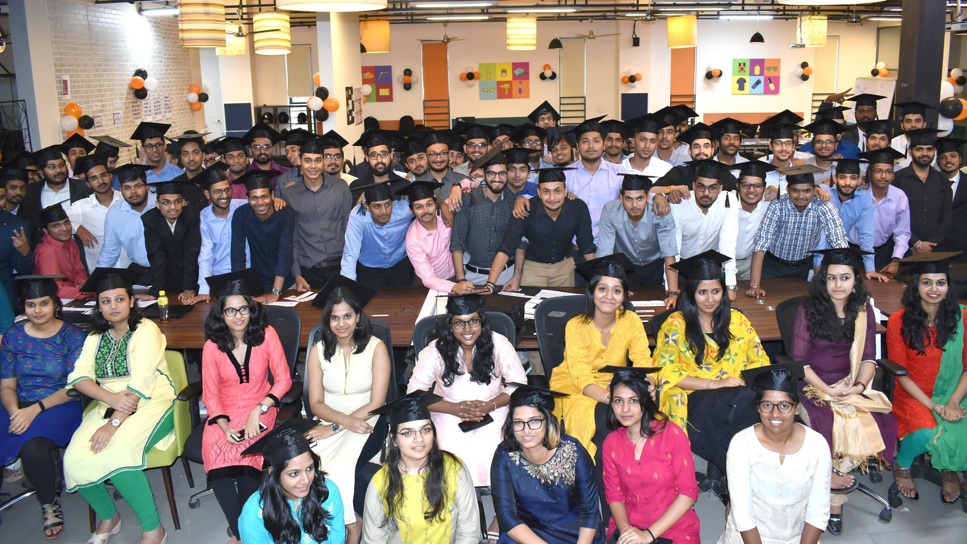




Unique approach to learning & training on the job
Email: devops@hashedin.com
https://hashedin.com/hashedin-university/
INDIA
#459, 17th Cross, HSR Layout, Bangalore, KA, 560102
This award-winning study showcases how fresh perspectives can be applied by new talent before they are entrenched in the organizational processes.

